Slide 1
The Fruit of Waiting
Book of Esther – Part 5
September 15, 2010

Slide 2
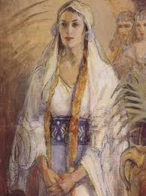
“If I perish, I perish!”

Slide 3
What Happens in the White Space?

Slide 4
What Happens in the White Space?
“Every good gift and every perfect gift is from above, and comes down from the Father of lights, with whom there is no variation or shadow of turning.”
James 1:17

Slide 5
What Happens in the White Space?
Esther waited on God

Slide 6
Waiting on the Lord
“But those who wait on the LORD shall renew their strength; they shall mount up with wings like eagles, they shall run and not be weary, they shall walk and not faint.” Isaiah 40:31

Slide 7
Waiting on the Lord
“But those who wait on the LORD shall renew their strength; they shall mount up with wings like eagles, they shall run and not be weary, they shall walk and not faint.” Isaiah 40:31
New strength

Slide 8
Waiting on the Lord
“But those who wait on the LORD shall renew their strength; they shall mount up with wings like eagles, they shall run and not be weary, they shall walk and not faint.” Isaiah 40:31
New strength
Better perspective

Slide 9
Waiting on the Lord
“But those who wait on the LORD shall renew their strength; they shall mount up with wings like eagles, they shall run and not be weary, they shall walk and not faint.” Isaiah 40:31
New strength
Better perspective
Extra energy/grace

Slide 10
Waiting on the Lord
“Fear not, for I am with you; be not dismayed, for I am your God. I will strengthen you, yes, I will help you, I will uphold you with My righteous right hand.’… For I, the LORD your God, will hold your right hand, saying to you, ‘Fear not, I will help you.’ Isaiah 41:10-13

Slide 11
Waiting is ACTIVE, not passive
“And you will seek Me and find Me, when you search for Me with all your heart.” Jeremiah 29:13

Slide 12
Waiting is ACTIVE, not passive
“You are my hiding place; You shall preserve me from trouble; You shall surround me with songs of deliverance. I will instruct you and teach you in the way you should go; I will guide you with My eye.” Psalm 32:7-8

Slide 13
A Wise Plan
See Esther 5:1-8

Slide 14
A Wise Plan
“The king’s heart is in the hand of the LORD, like the rivers of water; He turns it wherever He wishes.” Proverbs 21:1

Slide 15
A Wise Plan
“The king’s heart is in the hand of the LORD, like the rivers of water; He turns it wherever He wishes.” Proverbs 21:1
God can handle ANYONE!

Slide 16
An Arrogant Response
See Esther 5:9-16

Slide 17
An Arrogant Response
See Esther 5:9-16
No one can handle anger

Slide 18
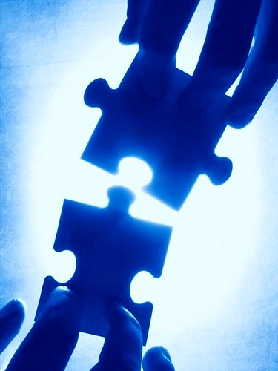

Slide 19
“But those who wait on the LORD shall renew their strength; they shall mount up with wings like eagles, they shall run and not be weary, they shall walk and not faint.” Isaiah 40:31

