Slide 1
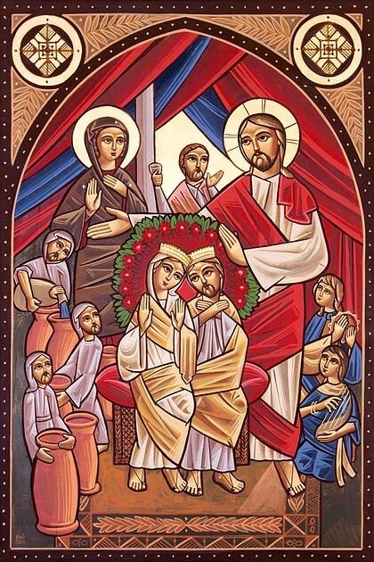
Schedule
St. Mark Marriage Retreat 2022
Talk 1: Fighting and Forgiving
Talk 2: Marriage as Salvation
Talk 3: Letting Christ in to heal the Marriage
Talk 4: Children as the path to YOUR salvation

Slide 2

Raising Children as the Path to YOUR salvation

Slide 3


Slide 4
What, Why and How…
What do we want for our kids? to stay off drugs, not marry the wrong person, don’t get involved with the wrong crowd, Successful career, etc
Is this the right motivation for spiritual life??
Why – so that we can ultimately see them in heaven and continue our relationship
How – the rest of the talk
My goal? Not to get invited back… “it’s not you, it’s me”

Slide 5
Why does God include us in the process of creation?
The love we have for our children, is flawed
But we see how much God must love us
Teaches us how loving He must be
Can God reveal Himself to us through our being a parent?
Can we reveal Him to our children through our parenting?

Slide 6
So how DO we handle the things our kids are seeing in school?
Listen calmly and don’t get angry,
Validate their feelings.
St John Chrysostom says “No matter how just your words may be, you ruin everything when you speak with anger.”
Point out the positives, help them see it from the point of view of a loving God. (story of St. Silouan’s father)

Slide 7
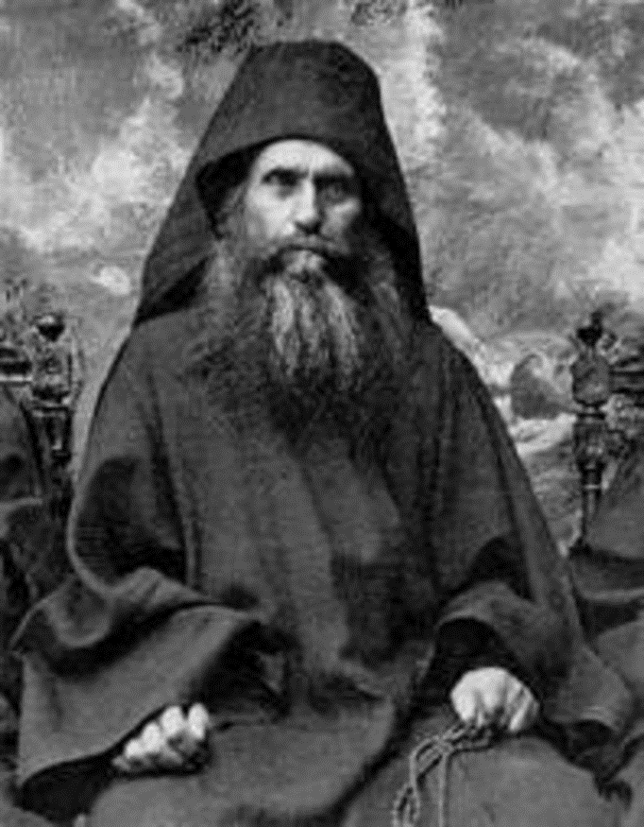
St. Silouan’s childhood
Family of peasants – 5 sons and 2 daughters
Loving father – Asked him to prepare dinner on Friday and he made pork. 6 Months later, his father brought it up to him…
"Why didn’t you tell me then?"
"I didn’t want to embarrass you."
In telling about these events from his life in his father’s house, the Elder would add, "This is the type of Elder one should be: he never became angry, always had an even and meek disposition. Think about it: he waited a half-year for a good moment to tell me without shaming me.“
Aren’t we called to be the Image of our father in heaven??

Slide 8
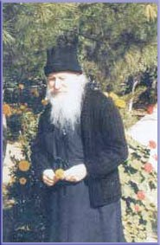
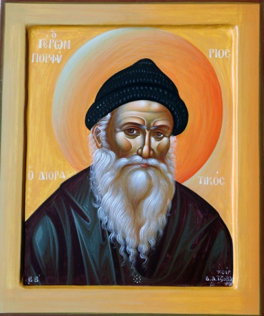
The life of Elder Porphyrios
Dec 2013 was canonized as a saint.
Monk of Mount Athos
Father Porphrios was assigned to the Athens Polyclinic in the heart of the city. Here he served the sick for thirty years, making his rounds through the hospital wards, celebrating the sacraments, praying with and guiding the sick.

Slide 9
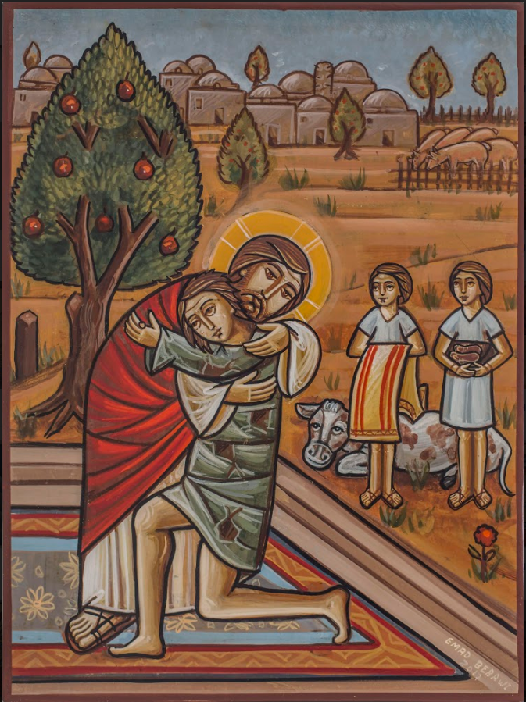
Teenagers…
After a decade or so of struggle and effort
Sacrifices made (giving of one’s life)
Love poured out without hesitation
Your teen looks at you and says…
“I will not reciprocate your love”
First reaction: Anger, sadness, guilt
Second reaction: Is this what I did to God?

Slide 10
What saves and makes for good children is the life of the parents in the home
“The parents need to devote themselves to the love of God. They need to become saints in their relation to their children through their mildness, patience and love. They need to make a new start every day, with a fresh outlook, renewed enthusiasm and love for their children. And the joy that will come to them, the holiness that will visit them, will shower grace on their children….

Slide 11
What saves and makes for good children is the life of the parents in the home
“….Generally the parents are to blame for the bad behavior of the children. And their behavior is not improved by reprimands, disciplining, or strictness. If the parents do not pursue a life of holiness and if they don't engage in spiritual struggle, they make great mistakes and transmit the faults they have within them.”

Slide 12
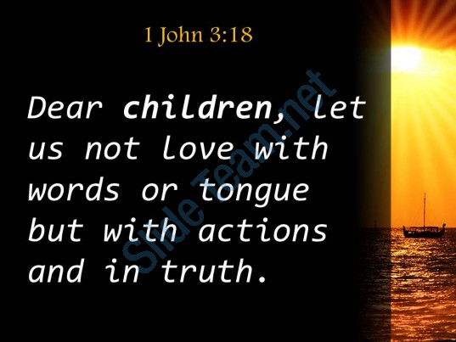

Slide 13
A large part of the responsibility for a person's spiritual state lies with the family. For children to be released from their various inner problems it is not enough for them to receive good advice, or to be compelled by force; nor do logical arguments or threats do any good. These things rather make matters worse. The solution is to be found through the sanctification of the parents. Become saints and you will have no problems with your children. The sanctity of their parents releases the children from their problems.

Slide 14
A child needs to be surrounded by people who pray and pray ardently
“A child needs to be surrounded by people who pray and pray ardently. A mother should not be satisfied by giving her child a physical caress, but should also coddle it with the caress of prayer. In the depths of its soul the child senses the spiritual caress that its mother conveys to it and is drawn to her. It feels security and certainty when its mother mystically embraces it with constant, intense and fervent prayer and releases it from whatever is oppressing it.”

Slide 15
“Pray, and when you have to, speak to your children with love. Lots of prayer and few words. Lots of prayer and few words for everyone. We mustn't become an annoyance, but rather pray secretly and then speak, and God will let us know in our hearts whether the others have accepted what we have said. If not, we won't speak. We will simply pray mystically. Because if we speak we become an annoyance and make others react or even infuriate them. That is why it is better to speak mystically to the heart of others through secret prayer rather than to their ears.”

Slide 16
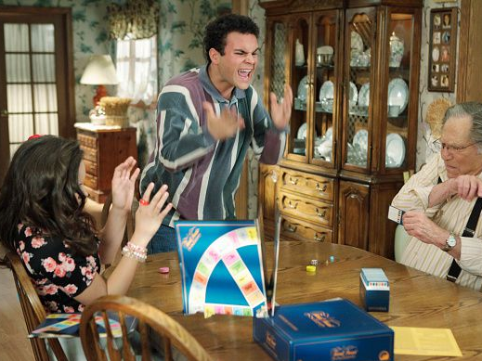
One Thanksgiving a few years back…

Slide 17
“This is the most perfect way — for the mother to speak to God and for God to speak to the children. If you do not communicate in this way, constant lecturing becomes a kind of intimidation. And when the child grows up it begins to rebel, that is, to take revenge, so to speak, on its father and mother who coerced it.”

Slide 18


Slide 19
“The life of the children seems to be affected by the radiation of their parents. If the parents insist, 'Come on now, go and make confession, go and receive Communion', and so on, nothing is achieved. But what does your child see in you? How do you live and what do you radiate? Does Christ radiate in you? That is what is transmitted to your child. This is where the secret lies. And if this is done when the child is young, it will not be necessary for it to undergo 'great travail' when it grows up.”

Slide 20
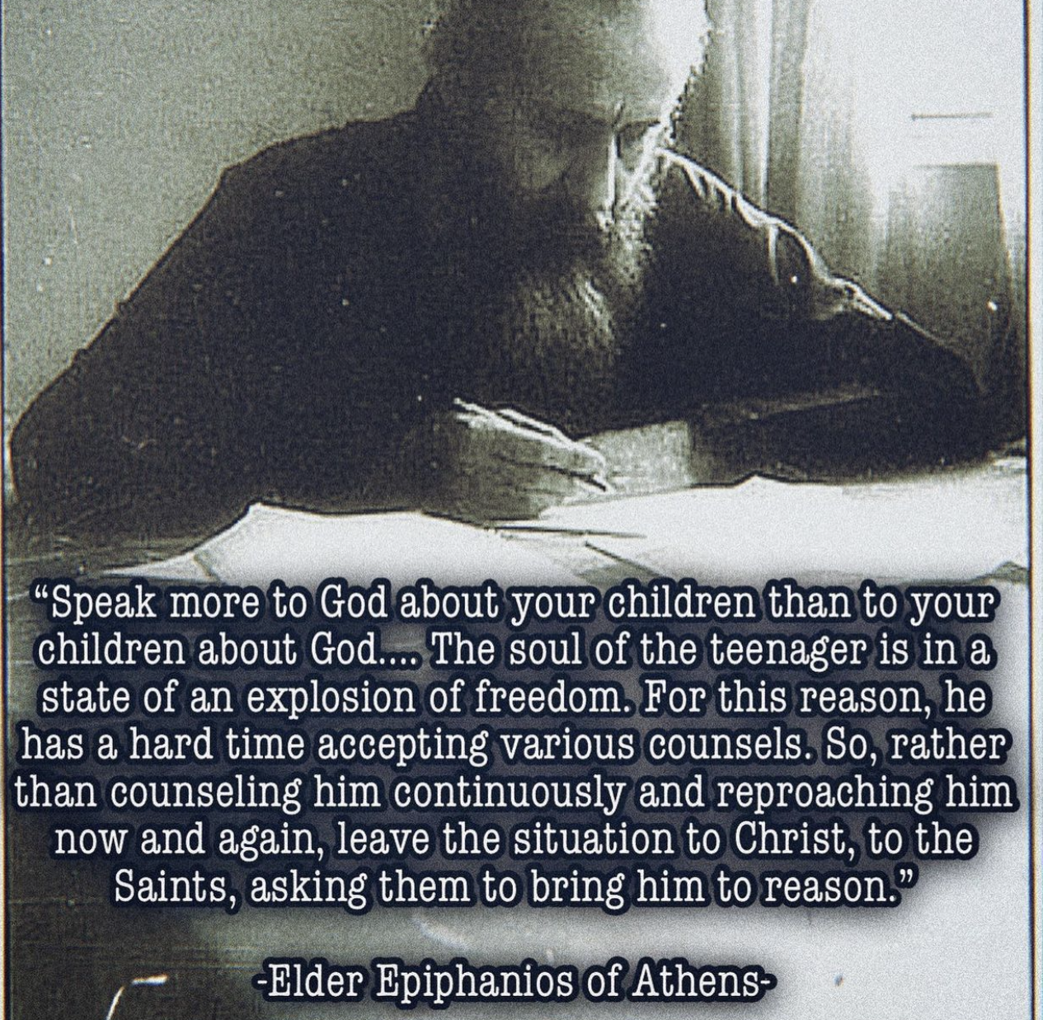

Slide 21
What do we pray for??
“We shouldn't continue relentlessly in order to acquire what we want; rather we should leave all things to the will of God. What happens when we pursue what we want? These wants always increase and we are never satisfied with what we have. The more we chase after these wants the more elusive they become. If we pray for good grades next we will ask for a good job. Then it will be for a better job and so forth. What should we ask for in our prayer? In our prayer we should ask only for the salvation of our soul...The secret is to ask for your union with Christ with utter selflessness, without saying "give me this" or "give me that." - St. Porphyrios

Slide 22
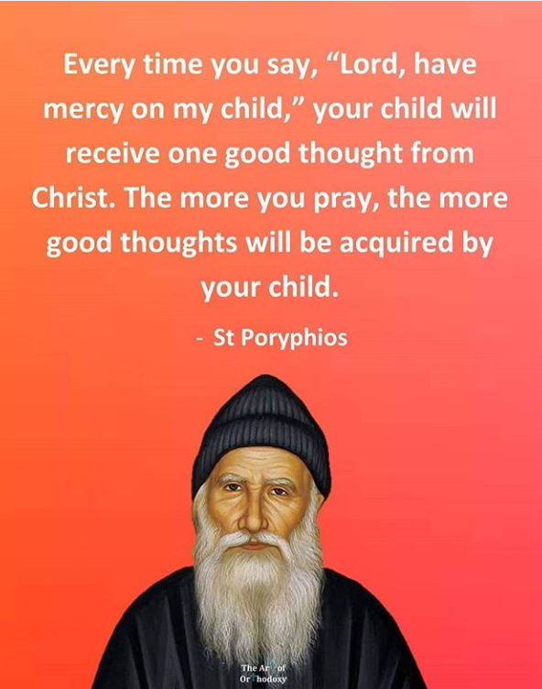

Slide 23
“You shouldn't say to a child, 'You'll succeed, you're great, you're young, you're fearless, you're perfect!' This is not good for the child. You can tell the child to pray, and say, 'The talents you have, have been given to you by God, Pray and God will give you strength to cultivate them and in that way you will succeed. God will give you His grace.' That is the best way. Children should learn to seek God's help in everything.”

Slide 24
“They fill them with egotistical words. They do not lead them to the spirit of God and they alienate them from the Church. When the children grow up a little and go to school with this egotism they abandon and disdain religion and they lose their respect for God, for their parents and for everyone. They become stubborn, hard and unfeeling, with no respect for religion or for God. We have produced a generation of egotists and not of Christians.”

Slide 25
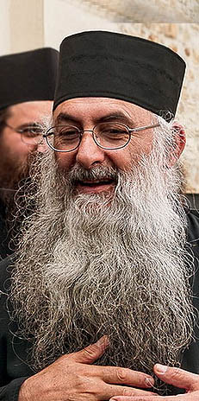

Someone gave me a question, "How can we be consoled in our pastoral ministry if we are giving and serving our people as much as we can and still feel inadequate to do and say to them all we know is needed. How can we be sure we are doing enough?"
Forgive me. We are never sure, but we trust in God and we do what we can and we leave the rest to God. We must pray for them above all that God speaks to their heart.
I knew a priest who had three sons, and they were like angels - the three of them. And I said to them, "Father, how did you manage to instruct them and that they are like angels?" One received ordination even, and the other two are chanters in his parish. "How did you manage to instruct them and they are so devout and so beautiful in their manner, in their ethos."

Slide 26
And he said to me, "Father, I never taught them anything. But from infancy, I used to go and kneel by their bed for half an hour in the night and pray for them. And all the things I wanted to tell them, I told God, and God put them in their hearts."
I think the same principle may apply for our parishioners. Let's speak to God all the things that we want the parishioners to [hear] and if we approach them with that prayer in our heart, surely, their heart will be touched and be informed. . . So, we can tell God first what we want to tell them, pray, and leave the matter to Him . . . and do what we can.
--Fr. Zacharias Zacharou

Slide 27
Things for you to do…
Objective: kids in church vs. knowing Christ through church?
Fr. Matthew the poor asking mom to work on herself to save girl
Example of Christ and disciples. “talks” don’t work. They learn from you teaching them.
Fr. Dawoud – parenting is “absorbed” by kids
History of Sunday school – it was introduced in a time of ignorance, corruption, massive weakness in the church and it was necessary for education. BUT IT DOES NOT RAISE SPIRITUAL CHILDREN

Slide 28
In conclusion… Maybe it should read… “I was selfish two kids ago”??

