Slide 1
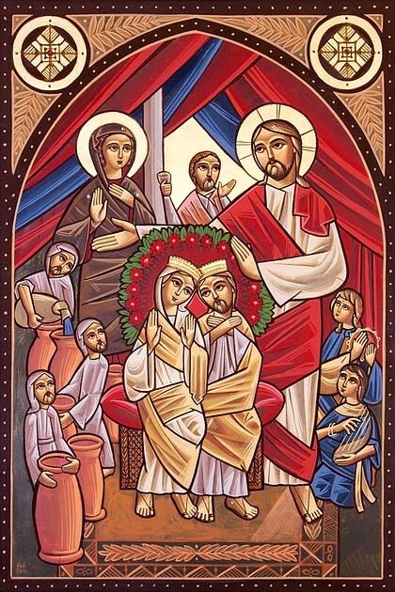
Schedule
St. Mark Marriage Retreat 2022
Talk 1: Fighting and Forgiving
Talk 2: Marriage as Salvation
Talk 3: Letting Christ in to heal the Marriage
Talk 4: Children as the path to Salvation

Slide 2
Talk 2:
Marriage as Salvation

Slide 3
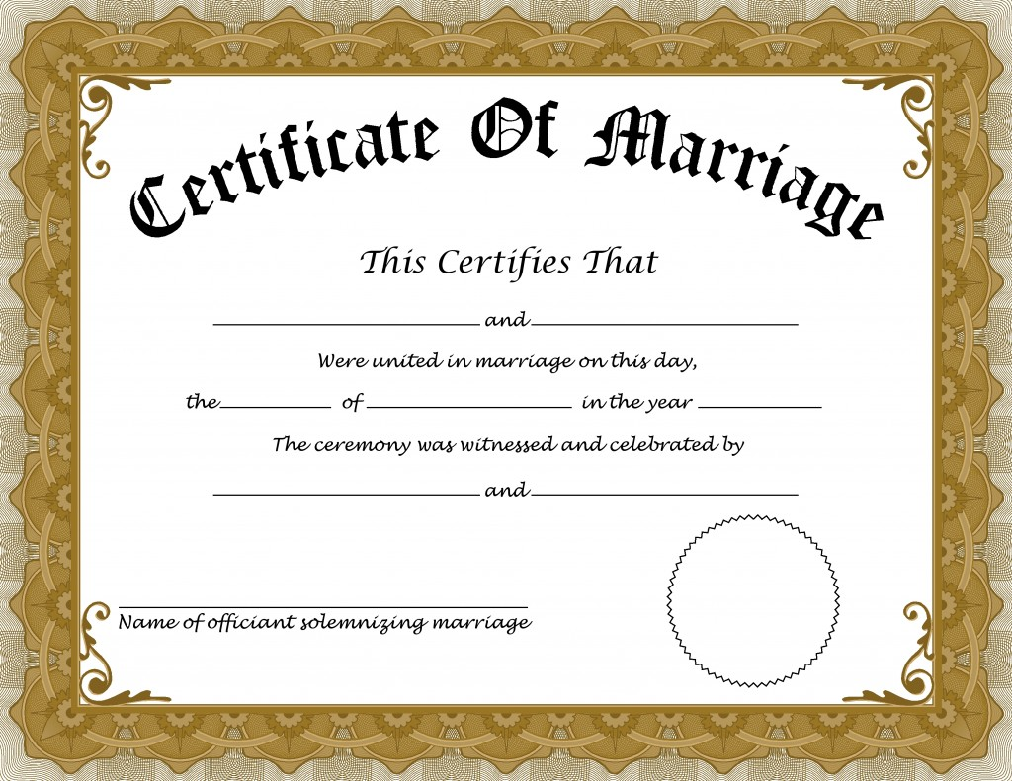
But isn’t marriage just a piece of paper?

Slide 4
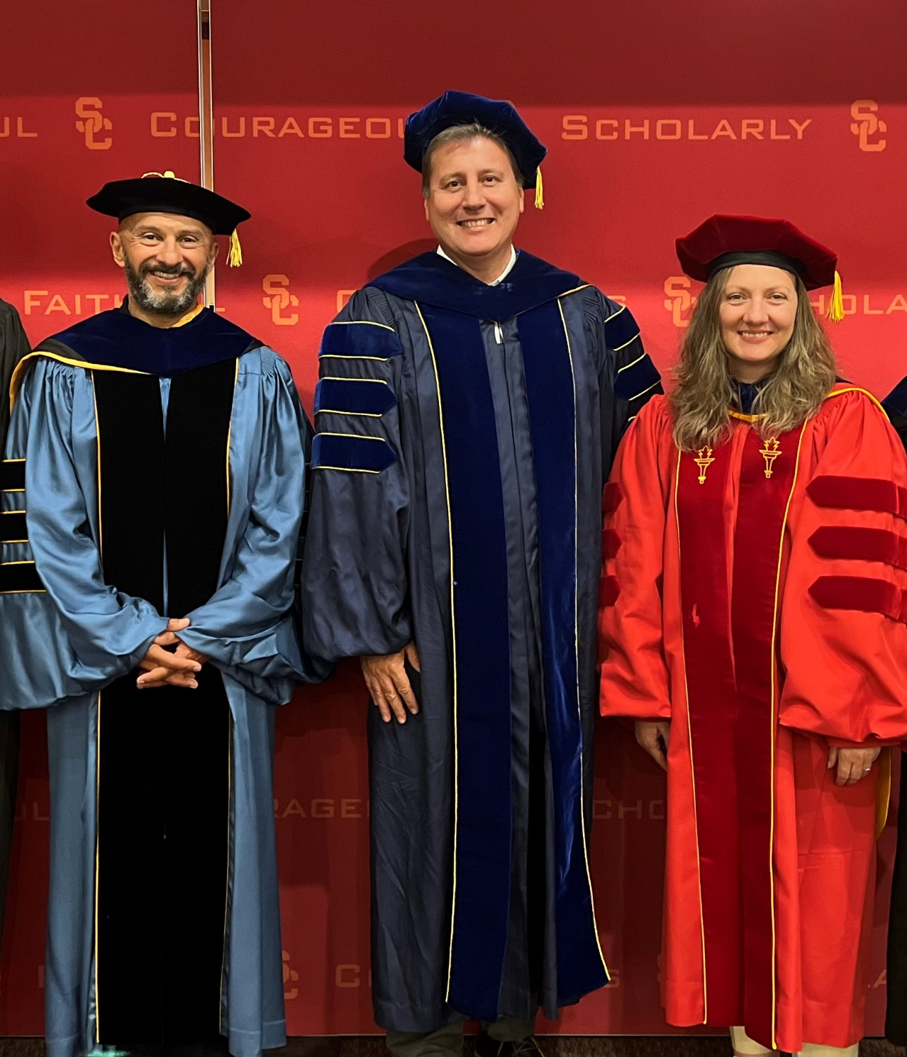

Bit about me…
I’m a professor at USC
FIGHT ON! ☺

Slide 5


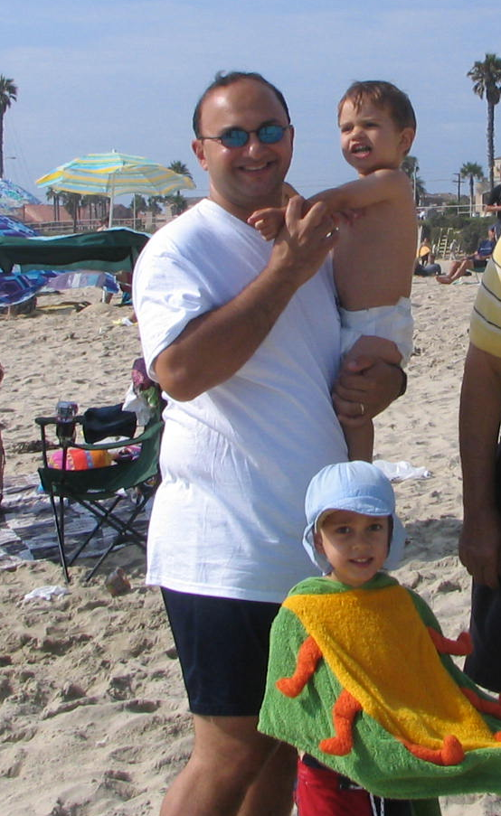
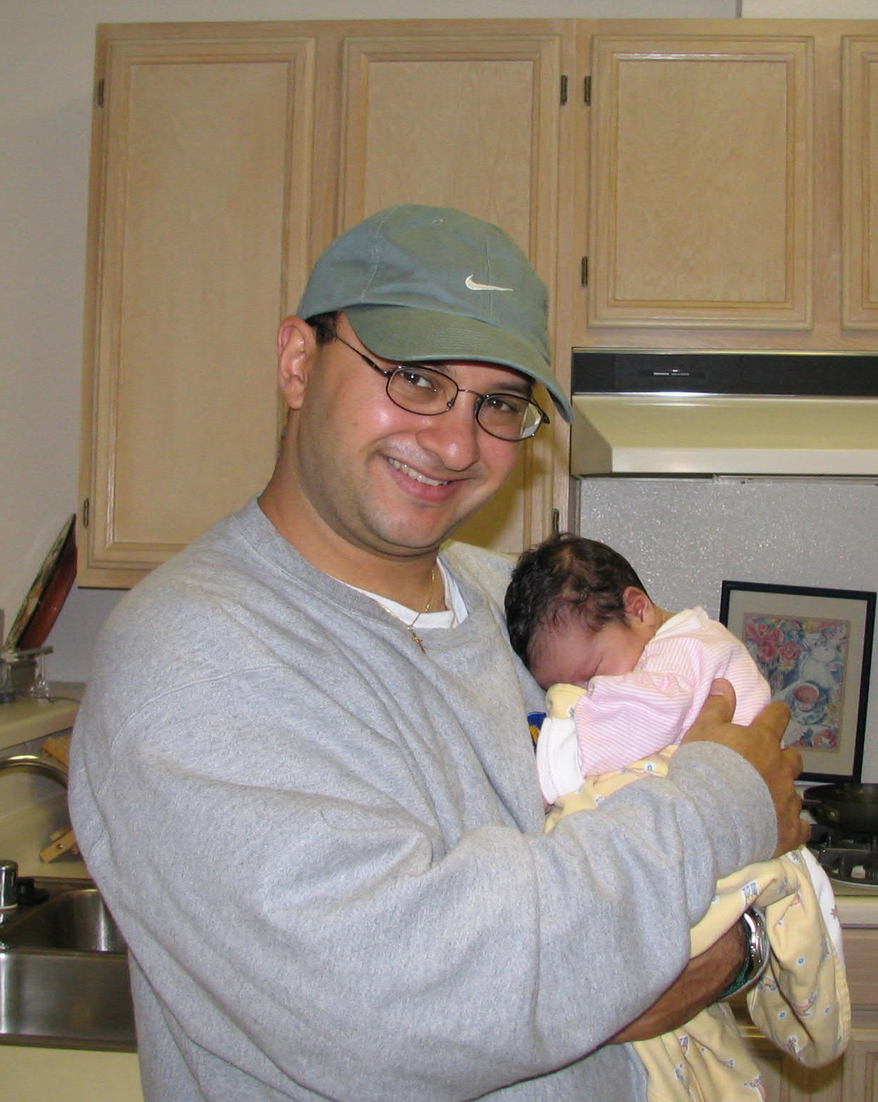
Little about me…
Ironman!
-2.4 mile swim
-112 mile bike
-26.2 mile run
50 lbs ago
Spartan Trifecta…

Slide 6

Half Ironman a few months ago with my sons!

Slide 7
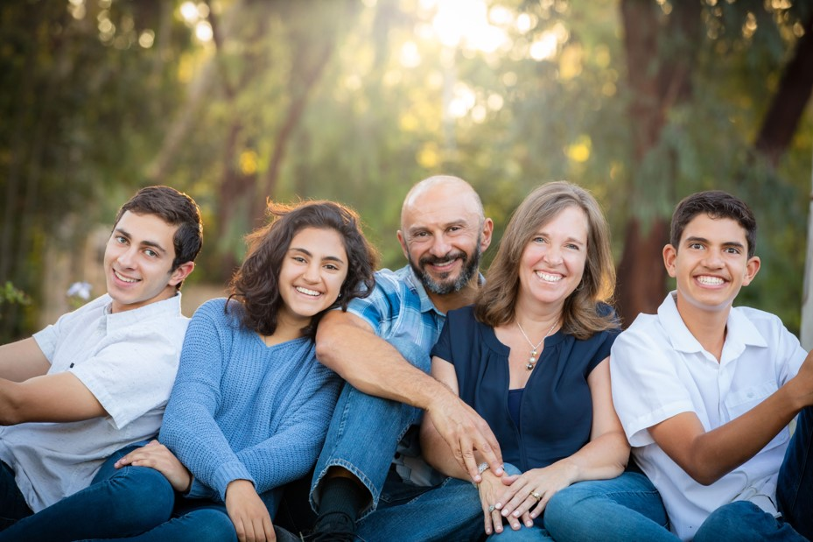
The Family…
Just celebrated our 25 year wedding anniversary!

Slide 8
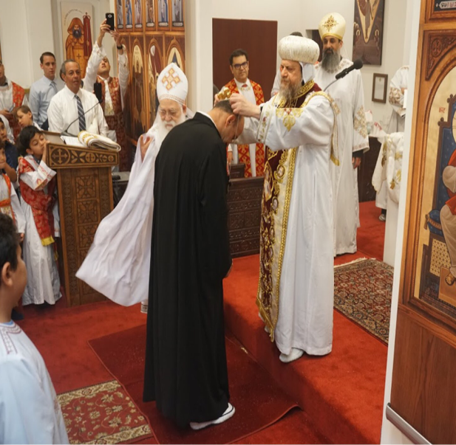
Ordained an Archdeacon on April 29, 2018

Slide 9
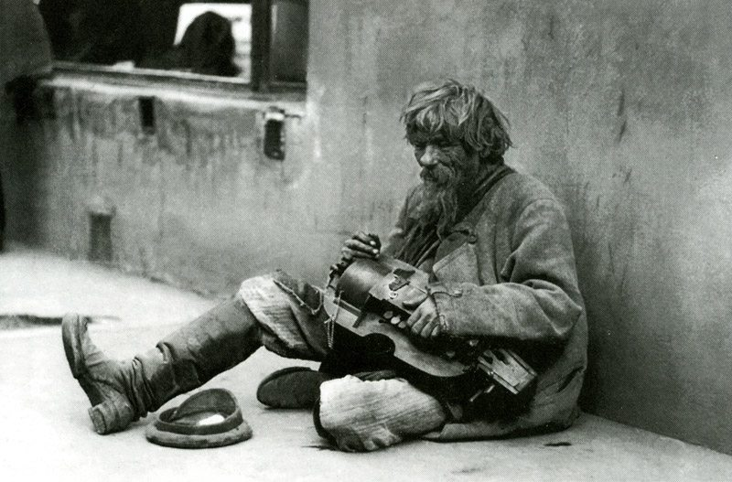
That is my outside appearance that I want all of you to see…
This is my Facebook and Instagram profile ☺ But what am I really???
I am a beggar and a broken man in need of help…

Slide 10
What is the essence of marriage?
Christian view: Long term binding commitment to a covenant
  Not passion and feeling because that comes and go.
  Covenant makes things more intimate
  Consumer view: get what I want that is best for me, leave when it’s not good.
  Covenant relationship: child relationship. Can’t leave when it cries.
Dating is consumer relationship – still marketing and selling “best”
Marriage – now I’m secure to be myself, intimate, not fake. Freedom!

Slide 11
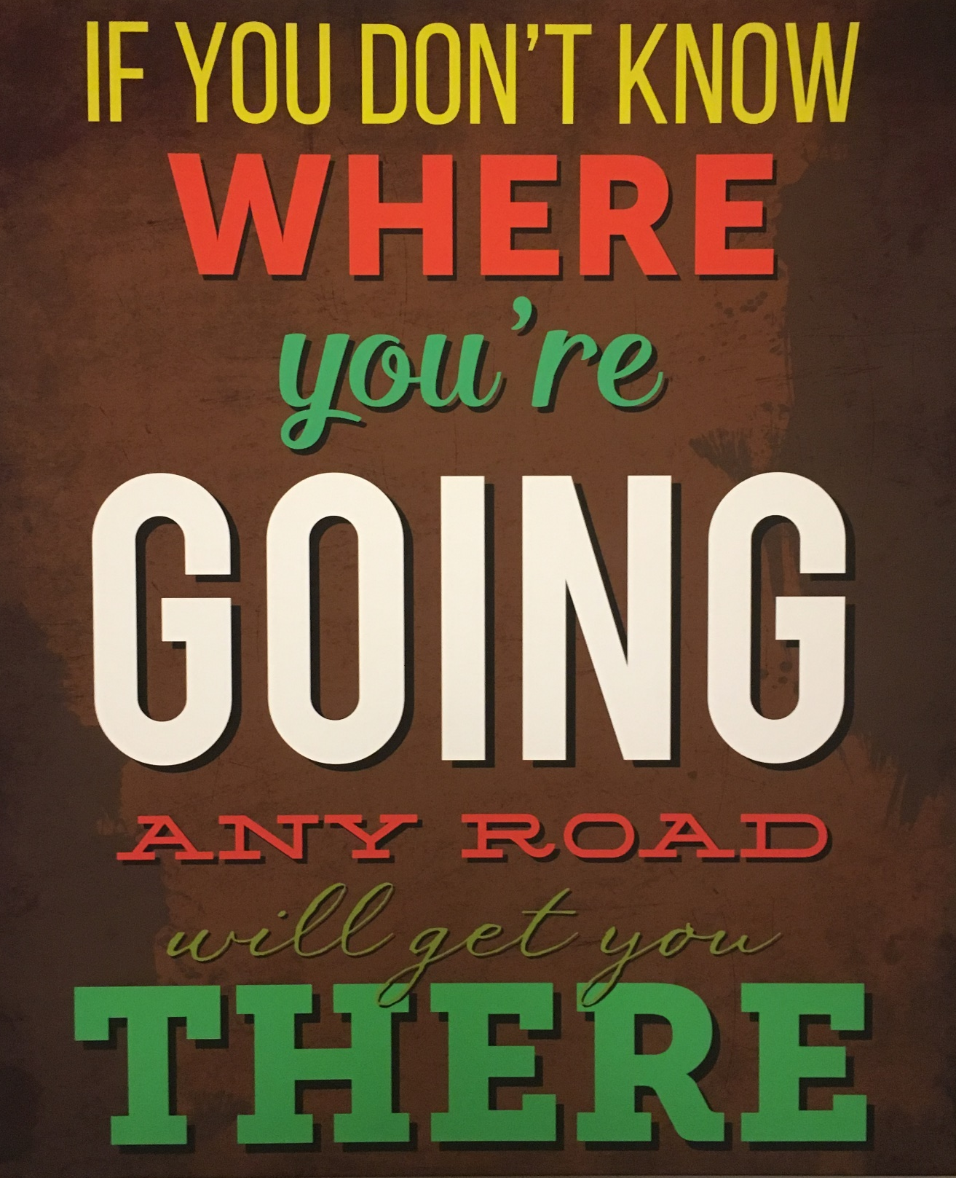
Most Marriage talks:
Scary statistics on divorce
Christianity helps you stay together
Stick with Christianity or else your marriage will fail…
Today, we will talk on marriage as the path to the Lord…

Slide 12
“For the Life of the World” by Alexander Schmemann
A marriage which does not constantly crucify its own selfishness and self-sufficiency, which does not ‘die to itself’ that it may point beyond itself, is not a Christian marriage. The real sin of marriage today is not adultery or lack of ‘adjustment’ or ‘mental cruelty.’ It is the idolization of the family itself, the refusal to understand marriage as directed toward the Kingdom of God. This is expressed in the sentiment that one would ‘do anything’ for his family, even steal. The family has here ceased to be for the glory of God; it has ceased to be a sacramental entrance into his presence. It is not the lack of respect for the family, it is the idolization of the family that breaks the modern family so easily, making divorce its almost natural shadow. It is the identification of marriage with happiness and the refusal to accept the cross in it. In a Christian marriage, in fact, three are married; and the united loyalty of the two toward the third, who is God, keeps the two in an active unity with each other as well as with God. Yet it is the presence of God which is the death of the marriage as something only ‘natural.’ It is the cross of Christ that brings the self-sufficiency of nature to its end. But ‘by the cross, joy entered the whole world.’ Its presence is thus the real joy of marriage. It is the joyful certitude that the marriage vow, in the perspective of the eternal Kingdom, is not taken ‘until death parts,’ but until death unites us completely.

Slide 13
“For the Life of the World” by Alexander Schmemann
A marriage which does not constantly crucify its own selfishness and self-sufficiency, which does not ‘die to itself’ that it may point beyond itself, is not a Christian marriage. The real sin of marriage today is not adultery or lack of ‘adjustment’ or ‘mental cruelty.’ It is the idolization of the family itself, the refusal to understand marriage as directed toward the Kingdom of God. This is expressed in the sentiment that one would ‘do anything’ for his family, even steal. The family has here ceased to be for the glory of God; it has ceased to be a sacramental entrance into his presence. It is not the lack of respect for the family, it is the idolization of the family that breaks the modern family so easily, making divorce its almost natural shadow. It is the identification of marriage with happiness and the refusal to accept the cross in it. In a Christian marriage, in fact, three are married; and the united loyalty of the two toward the third, who is God, keeps the two in an active unity with each other as well as with God. Yet it is the presence of God which is the death of the marriage as something only ‘natural.’ It is the cross of Christ that brings the self-sufficiency of nature to its end. But ‘by the cross, joy entered the whole world.’ Its presence is thus the real joy of marriage. It is the joyful certitude that the marriage vow, in the perspective of the eternal Kingdom, is not taken ‘until death parts,’ but until death unites us completely.

Slide 14
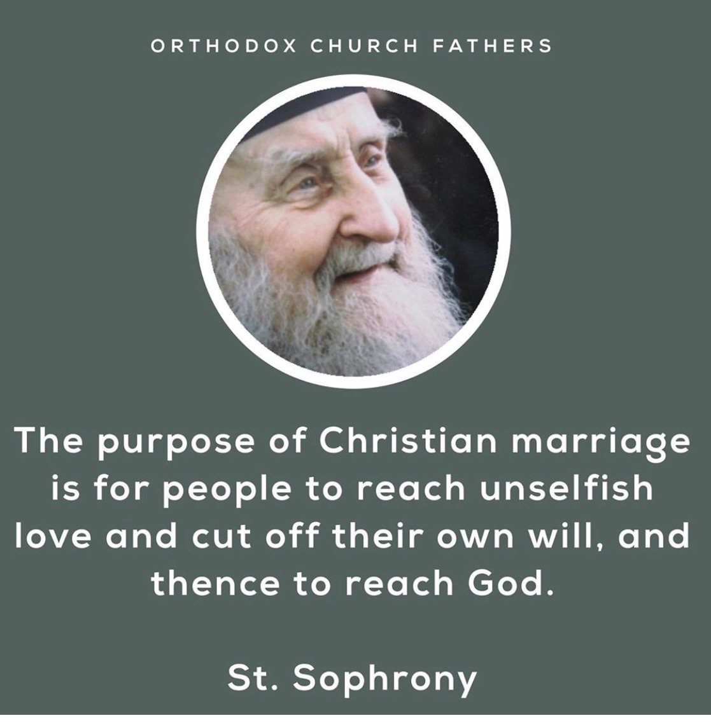
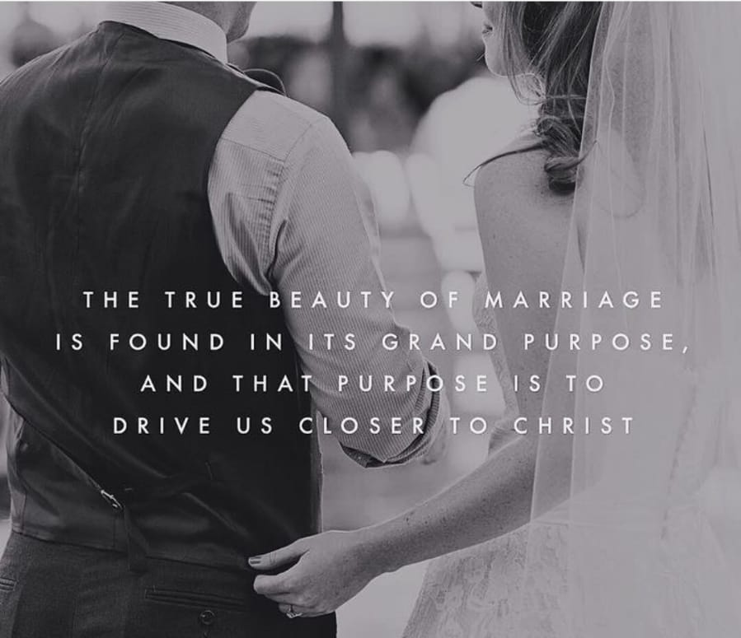

Slide 15
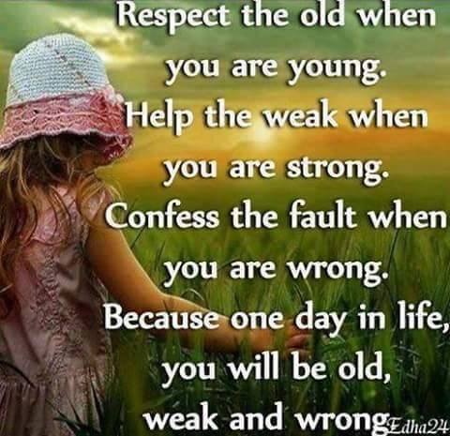
Think of the vows
Mother Theresa…
They are not “I feel great towards you now and love you”
But: I will love you even when you suck, you are weak…
Otherwise your enslaved to impulse, feelings, moment, passion.
An old Jewish guy once said…
Some day you will be old, weak and wrong….

Slide 16
“For the Life of the World” by Alexander Schmemann
A marriage which does not constantly crucify its own selfishness and self-sufficiency, which does not ‘die to itself’ that it may point beyond itself, is not a Christian marriage. The real sin of marriage today is not adultery or lack of ‘adjustment’ or ‘mental cruelty.’ It is the idolization of the family itself, the refusal to understand marriage as directed toward the Kingdom of God. This is expressed in the sentiment that one would ‘do anything’ for his family, even steal. The family has here ceased to be for the glory of God; it has ceased to be a sacramental entrance into his presence. It is not the lack of respect for the family, it is the idolization of the family that breaks the modern family so easily, making divorce its almost natural shadow. It is the identification of marriage with happiness and the refusal to accept the cross in it. In a Christian marriage, in fact, three are married; and the united loyalty of the two toward the third, who is God, keeps the two in an active unity with each other as well as with God. Yet it is the presence of God which is the death of the marriage as something only ‘natural.’ It is the cross of Christ that brings the self-sufficiency of nature to its end. But ‘by the cross, joy entered the whole world.’ Its presence is thus the real joy of marriage. It is the joyful certitude that the marriage vow, in the perspective of the eternal Kingdom, is not taken ‘until death parts,’ but until death unites us completely.

Slide 17
What is the mission of your marriage? Purpose?
According to Christian: Deep character change through deep friendship
People are looking today for “a perfectly compatible soul mate”
What is that? “Someone who will accept me as I am but not change me”
Those people don’t exist. You want someone to do that for you, but you don’t want to do it for someone else.
We come into marriage with flaws:
  Fearful, proud, inflexible, unreliable, impatient, perfectionist, critical, coward that twists the truth to look good.
We ALL have stuff like this! But your flaws never sunk in when told about it!
BTW, this is why the period of engagement must be a period of repentance!

Slide 18

All people are flawed…

Slide 19
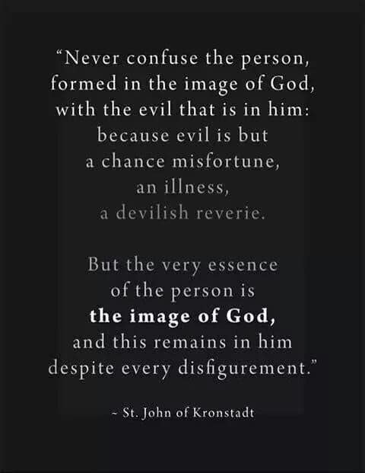
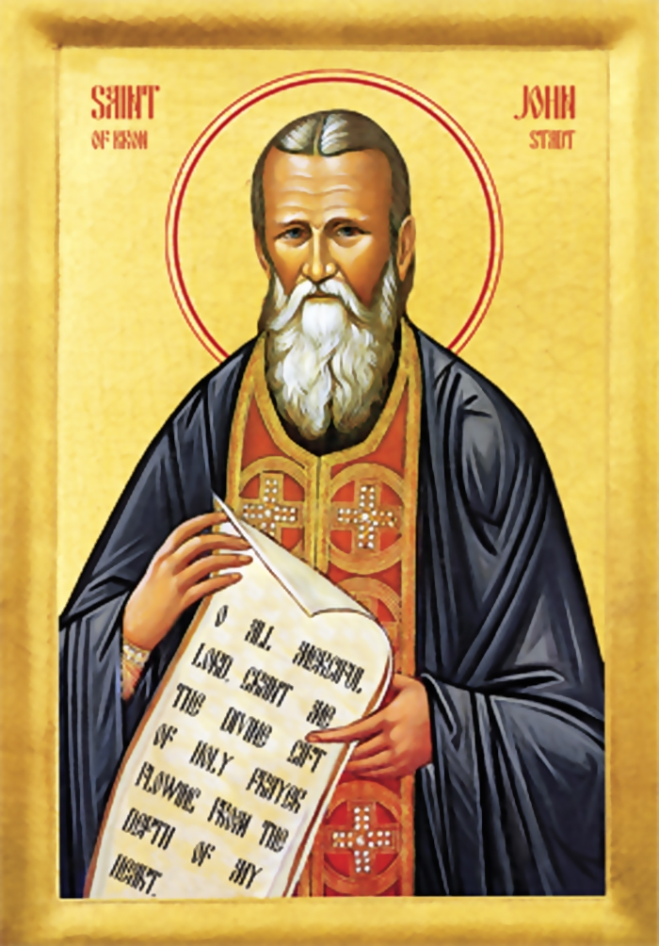
Who (what) are you actually married to?

Slide 20
Christ and the Church…
Christ
-Protects
-Loves
-Died for
-Supports
-Is compassionate
-Tender and merciful
- Provides for
Loves
Respects
Serves
Obeys
Church

Slide 21
St. Paul tells us to swap these words!
Husband
-Protects
-Loves
-Died for
-Supports
-Is compassionate
-Tender and merciful
- Provides for
Loves
Respects
Serves
Obeys
Wife

Slide 22
St. Paul says…
Wives, submit yourselves to your own husbands as you do to the Lord. For the husband is the head of the wife as Christ is the head of the church, his body, of which he is the Savior. Now as the church submits to Christ, so also wives should submit to their husbands in everything.
Husbands, love your wives, just as Christ loved the church and gave himself up for her to make her holy…. In this same way, husbands ought to love their wives as their own bodies. He who loves his wife loves himself. After all, no one ever hated their own body, but they feed and care for their body, just as Christ does the church— for we are members of his body. … However, each one of you also must love his wife as he loves himself, and the wife must respect her husband.

Slide 23
St. Paul says…
Wives, submit yourselves to your own husbands as you do to the Lord. For the husband is the head of the wife as Christ is the head of the church, his body, of which he is the Savior. Now as the church submits to Christ, so also wives should submit to their husbands in everything.
Husbands, love your wives, just as Christ loved the church and gave himself up for her to make her holy…. In this same way, husbands ought to love their wives as their own bodies. He who loves his wife loves himself. After all, no one ever hated their own body, but they feed and care for their body, just as Christ does the church— for we are members of his body. … However, each one of you also must love his wife as he loves himself, and the wife must respect her husband.

Slide 24
How does Marriage bring you closer to Christ?
Let’s start with the men… ☺
What are men like? Sacrificing? Thoughtful? Selfless? Think of others?
NO!!!
Selfish, stubborn, worried about themselves…
St. Paul tells men “love their wives as their own bodies”
This is VERY hard for men! But it is our salvation…

Slide 25
Remember this??
Husband
-Protects
-Loves
-Died for
-Supports
-Is compassionate
-Tender and merciful
- Provides for
Wife

Slide 26
The Women’s turn?
Wives, submit yourselves to your own husbands as you do to the Lord. For the husband is the head of the wife as Christ is the head of the church, his body, of which he is the Savior. Now as the church submits to Christ, so also wives should submit to their husbands in everything.
Husbands, love your wives, just as Christ loved the church and gave himself up for her to make her holy…. In this same way, husbands ought to love their wives as their own bodies. He who loves his wife loves himself. After all, no one ever hated their own body, but they feed and care for their body, just as Christ does the church— for we are members of his body. … However, each one of you also must love his wife as he loves himself, and the wife must respect her husband.

Slide 27
How does Marriage bring you closer to Christ?
What are women like? ☺
Do they like to be told what to do?
Ordered around?
Listen to a MAN? (who is usually dumber than her)
NO!! Head strong, stubborn, have their way of doing things, don't want to be told what to do!!
St. Paul says, “wives should submit to their husbands in everything”
This is VERY hard for women! But it is their salvation…

Slide 28
Remember this??
Husband
Loves
Respects
Serves
Obeys
Wife

Slide 29
“When we speak of the wife obeying the husband, we normally think of obedience in military or political terms: the husband giving orders, and the wife obeying them. But while this type of obedience may he appropriate in the army, it is ridiculous in the intimate relationship of marriage. The obedient wife does not wait for orders. Rather, she tries to discern her husband’s needs and feelings, and responds in love. When she sees her husband is weary, she encourages him to rest; when she sees him agitated, she soothes him; when he is ill, she nurses and comforts him; when he is happy and elated, she shares his joy. Yet such obedience should not be confined to the wife; the husband should be obedient in the same way. When she is weary, he should relieve her of her work; when she is sad, he should cherish her, holding her gently in his arms; when she is filled with good cheer, he should also share her good cheer. Thus a good marriage is not a matter of one partner obeying the other, but of both partners obeying each other.”
- St John Chrysostom

Slide 30
“For the Life of the World” by Alexander Schmemann
A marriage which does not constantly crucify its own selfishness and self-sufficiency, which does not ‘die to itself’ that it may point beyond itself, is not a Christian marriage. The real sin of marriage today is not adultery or lack of ‘adjustment’ or ‘mental cruelty.’ It is the idolization of the family itself, the refusal to understand marriage as directed toward the Kingdom of God. This is expressed in the sentiment that one would ‘do anything’ for his family, even steal. The family has here ceased to be for the glory of God; it has ceased to be a sacramental entrance into his presence. It is not the lack of respect for the family, it is the idolization of the family that breaks the modern family so easily, making divorce its almost natural shadow. It is the identification of marriage with happiness and the refusal to accept the cross in it. In a Christian marriage, in fact, three are married; and the united loyalty of the two toward the third, who is God, keeps the two in an active unity with each other as well as with God. Yet it is the presence of God which is the death of the marriage as something only ‘natural.’ It is the cross of Christ that brings the self-sufficiency of nature to its end. But ‘by the cross, joy entered the whole world.’ Its presence is thus the real joy of marriage. It is the joyful certitude that the marriage vow, in the perspective of the eternal Kingdom, is not taken ‘until death parts,’ but until death unites us completely.

Slide 31
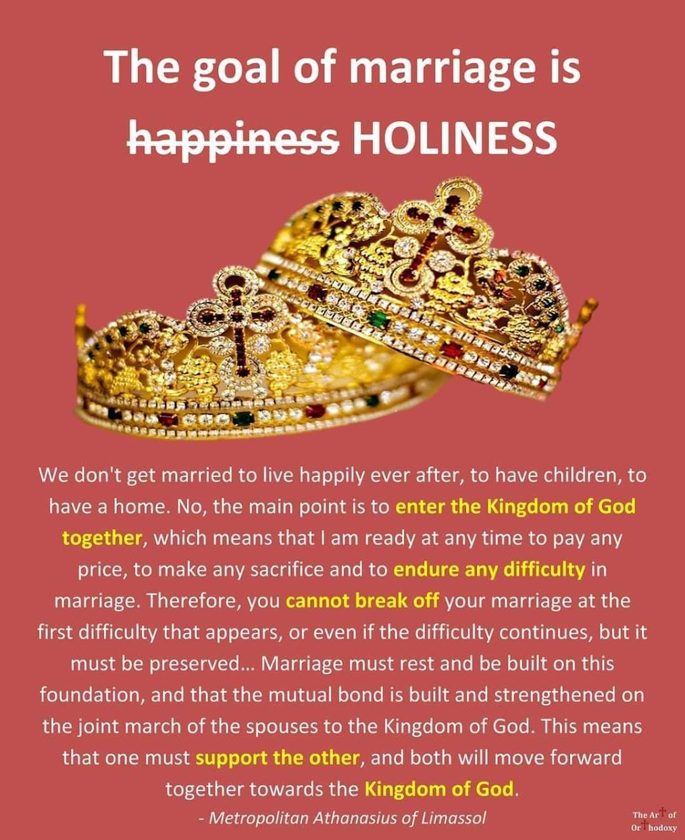

Slide 32
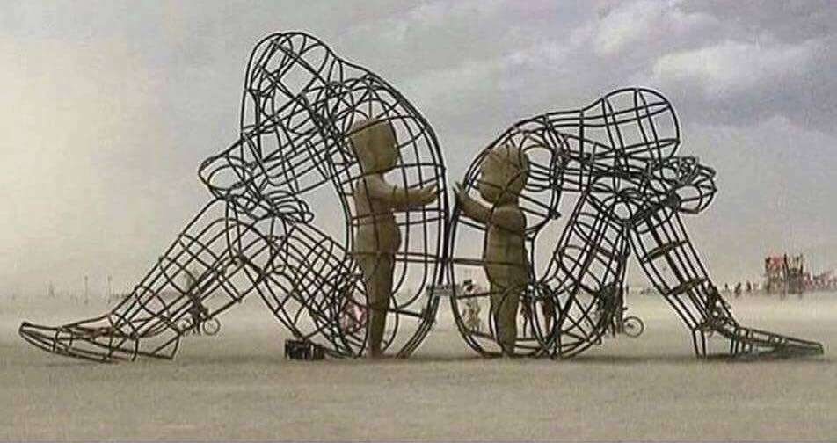
Ever do this??
From Burning Man: A sculpture of two adults after a disagreement, sitting with their backs to each other. Yet, the inner child in both of them simply wants to connect. Age brings pride and resentment we hold onto when we have conflicts with others. The forgiving, free spirit of children is our true nature.

Slide 33
Ever do this??
“Truly I tell you, unless you change and become like little children, you will never enter the kingdom of heaven.”
--Jesus

Slide 34
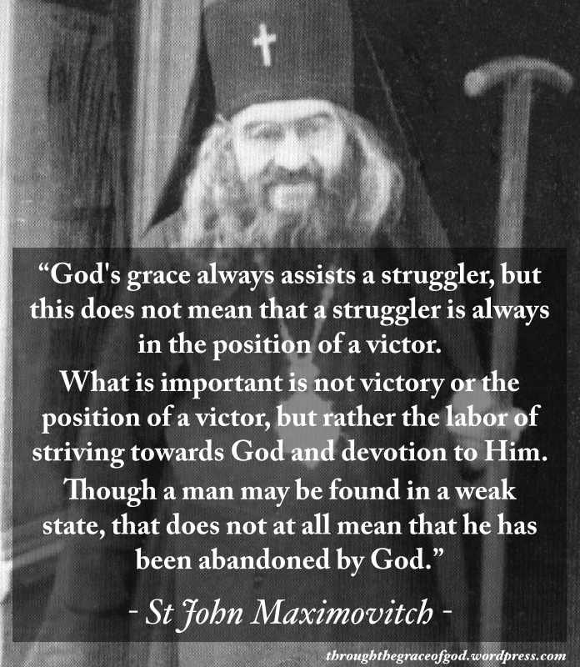

Slide 35
When you see difficulties in your marriage, when you see that you're making no progress in your spiritual life, don't despair. ..Lift up your heart to God…It is an adulteration of marriage for us to think that it is a road to happiness, as if it were a denial of the cross. The joy of marriage is for husband and wife to put their shoulders to the wheel and together go forward on the uphill road of life. "You haven't suffered? Then you haven't loved", says a certain poet. Only those who suffer can really love. And that's why sadness is a necessary feature of marriage. "Marriage", in the words of an ancient philosopher, "is a world made beautiful by hope, and strengthened by misfortune". Just as steel is fashioned in a furnace, just so is a person proved in marriage, in the fire of difficulties...Marriage, then, is a journey through sorrows and joys….

Slide 36
…when the sorrows seem overwhelming, then you should remember that God is with you. He will take up your cross. It was he who placed the crown of marriage on your head...Second, marriage is a journey of love. It is the creation of a new human being, a new person, for, as the Gospel says, "the two will be as one flesh." God unites two people, and makes them one. From this union of two people, who agree to synchronize their footsteps and harmonize the beating of their hearts, a new human being emerges. Through such profound and spontaneous love, the one becomes a presence, a living reality, in the heart of the other. "I am married" means that I cannot live a single day, even a few moments, without the companion of my life. My husband, my wife, is a part of my being, of my flesh, of my soul. He or she complements me. He or she is the thought of my mind. He or she is the reason for which my heart beats. - Elder Aimilianos of Simonopetra

Slide 37
“Imagine that the world is a circle, that God is the center, and that the radii are the different ways human beings live. When those who wish to come closer to God walk towards the center of the circle, they come closer to one another at the same time as to God. The closer they come to God, the closer they come to one another. And the closer they come to one another, the closer they come to God.”
--Abba Dorotheos of Gaza (6th century)
Final piece of advice…

Slide 38
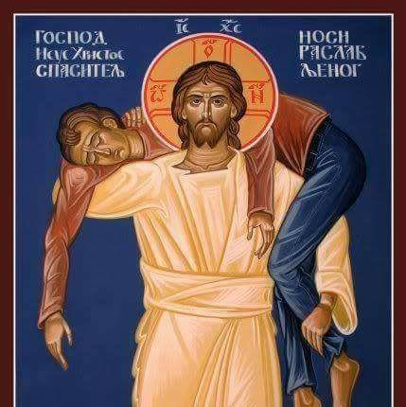
- All this sounds very difficult to do!!
- It doesn’t sound like it’s even humanly possible!
- How do we do all this??
You don’t… topic of the next talk!

Slide 39
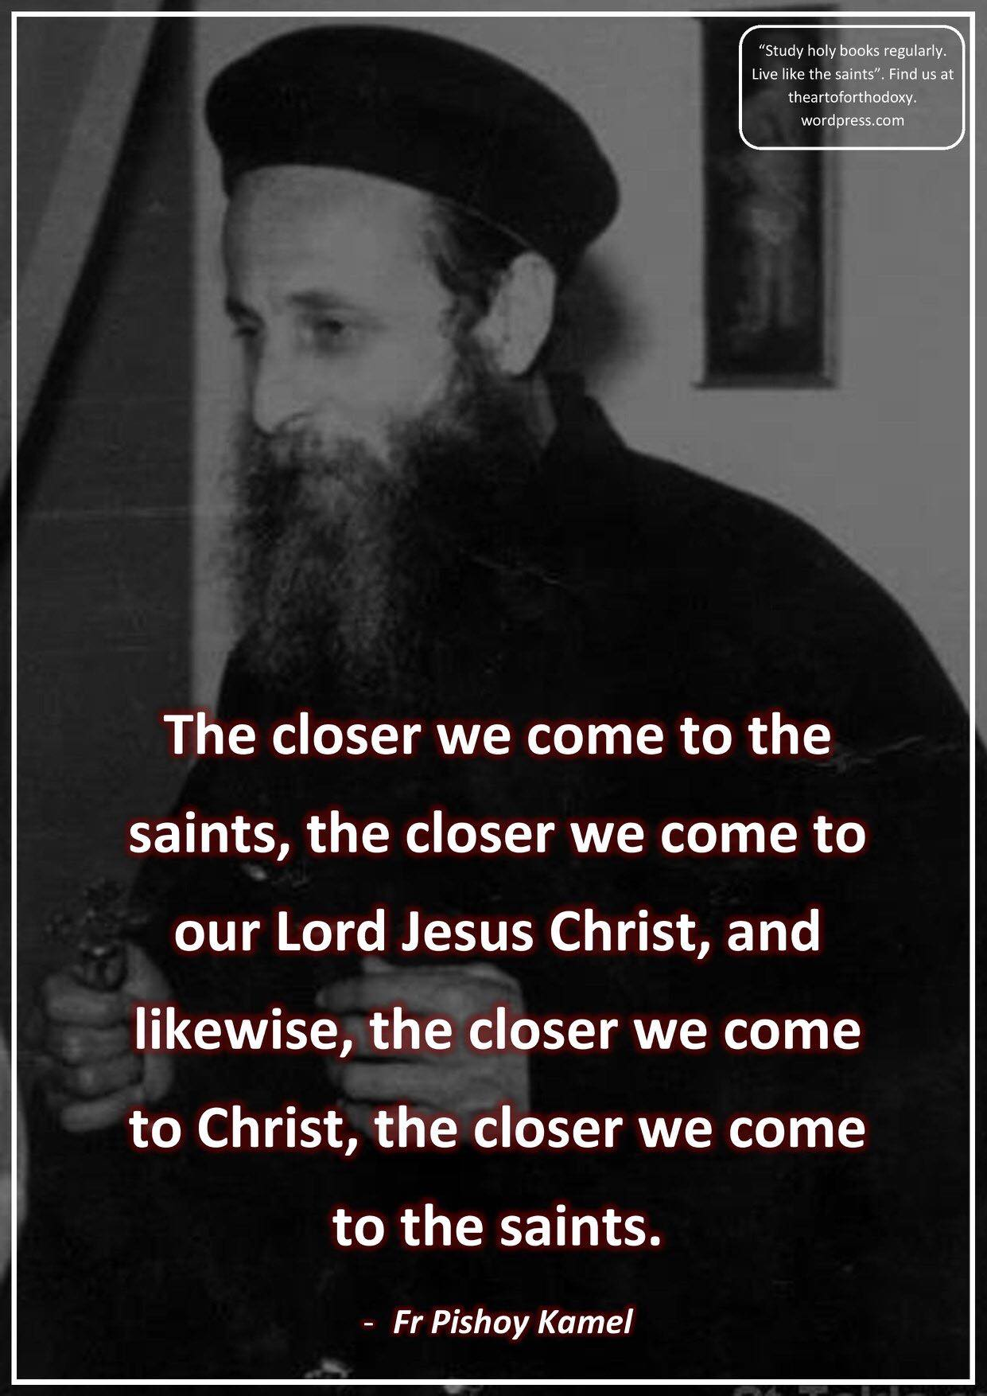
“Imagine that the world is a circle, that God is the center, and that the radii are the different ways human beings live. When those who wish to come closer to God walk towards the center of the circle, they come closer to one another at the same time as to God. The closer they come to God, the closer they come to one another. And the closer they come to one another, the closer they come to God.”
--Abba Dorotheos of Gaza (6th century)

Slide 40
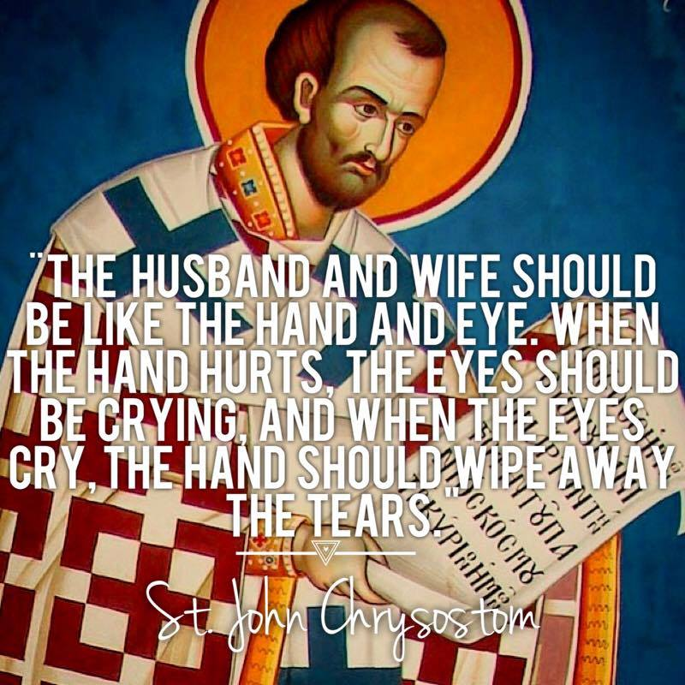
“If a man and a woman marry to satisfy their sexual appetites, or to further the material aims of themselves or their families, then the union is unlikely to bring blessings. But if a man and a woman marry in order to be companions on the journey through earth to heaven, then their union will bring great joy to themselves and to others.”
--St. John Chrysostom, from “On Living Simply”

