Slide 1
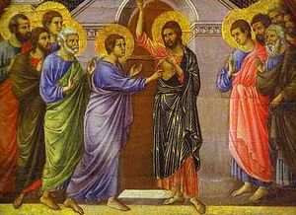
Resurrection is the power for change
Thomas Sunday = Antipascha = New Sunday 2019

Slide 2
Ignatius (d.117 AD) was a disciple of the apostle John. In his epistle to the Smyrnaeans Ignatius
"For I know and believe that He [Jesus] was IN THE FLESH EVEN AFTER THE RESURRECTION."(12)

Slide 3
1. From Fear to peace
Then, the same day at evening, being the first day of the week, when the doors were shut where the disciples were assembled, for fear of the Jews, Jesus came and stood in the midst, and said to them, “Peace be with you.” V20

Slide 4
2. From Doubt to belief
The other disciples therefore said to him, “We have seen the Lord.” So he said to them, “Unless I see in His hands the print of the nails, and put my finger into the print of the nails, and put my hand into His side, I will not believe.” V 25
And Thomas answered and said to Him, “My Lord and my God!” V 28

Slide 5
3. From Sadness to Joy
When He had said this, He showed them His hands and His side. Then the disciples were glad when they saw the Lord v20

Slide 6
4. From Useless to Missionaries
So Jesus said to them again, “Peace to you! As the Father has sent Me, I also send you.” ²² And when He had said this, He breathed on them, and said to them, “Receive the Holy Spirit. ²³ If you forgive the sins of any, they are forgiven them; if you retain the sins of any, they are retained.” v 21-23

Slide 7
St Athanasius on the Incarnation ch.48
These things which we have said are no mere words: they are attested by actual experience. Anyone who likes may see the proof of glory in the virgins of Christ, and in the young men who practice chastity as part of their religion, and in the assurance of immortality in so great and glad a company of martyrs. Anyone, too, may put what we have said to the proof of experience in another way

