Slide 1
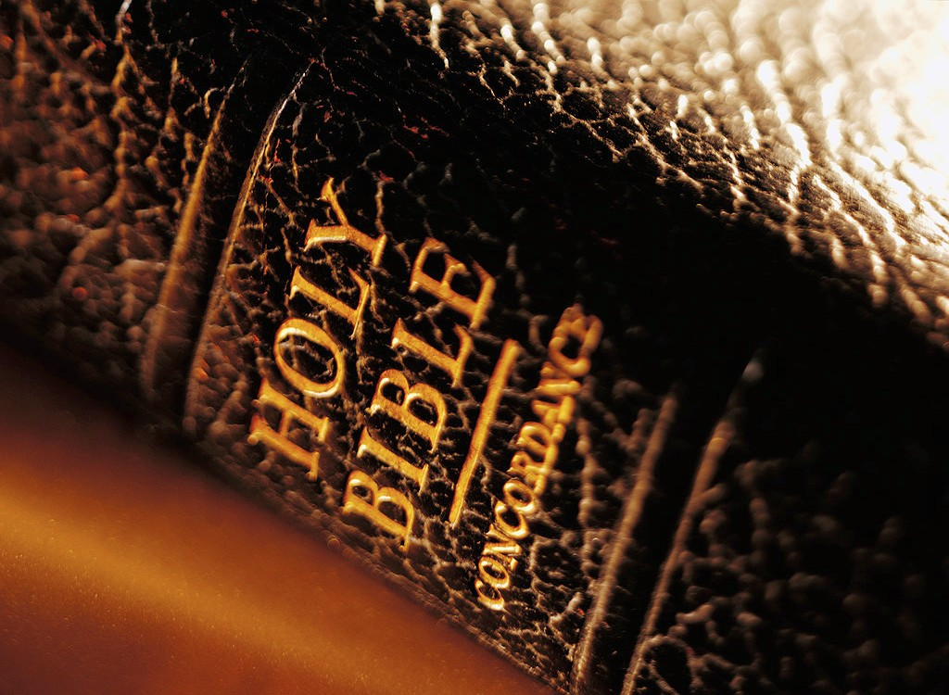
I have found the Book
2nd Sunday of Hatour 1736/2019

Slide 2
THE BIBLE IS NOT A GOOD LUCK CHARM
In George Foreman’s book, God in My Corner, the former heavyweight boxing champion writes: “In 1974, before I went to Africa to fight Muhammad Ali, a friend gave me a Bible to take along on my trip. He said, ‘George, keep this with you for good luck.’ I believed the Bible was just a shepherd’s handbook, probably because the only verse I knew was ‘the Lord is my shepherd.’ But I was always looking for luck, so I carried that Bible with me. I had lucky pennies and good luck charms, so now I added the ‘lucky’ Bible to my collection of superstitious items.
After I lost the fight, I threw the Bible away. I never even opened it. I thought, The Bible didn’t help me win, so why do I need it? I thought I’d get power simply from owning it; I didn’t realize that I needed to read it and believe what it says. Since then, I’ve come to understand that the Bible is my road map, not my good luck charm.”

Slide 3
I have found the book
14 While they were bringing out the money that had been taken into the temple of the Lord, Hilkiah the priest found the Book of the Law of the Lord that had been given through Moses. 15 Hilkiah said to Shaphan the secretary, “I have found the Book of the Law in the temple of the Lord.” He gave it to Shaphan. 2Chr 34

Slide 4
I heard the Word
And Shaphan read from it in the presence of the king.
19 When the king heard the words of the Law, he tore his robes. 20 He gave these orders to Hilkiah, Ahikam son of Shaphan, Abdon son of Micah,[a] Shaphan the secretary and Asaiah the king’s attendant: 21 “Go and inquire of the Lord for me and for the remnant in Israel and Judah about what is written in this book that has been found. Great is the Lord’s anger that is poured out on us because those who have gone before us have not kept the word of the Lord; they have not acted in accordance with all that is written in this book.” 2 Chr 34

Slide 5
I am responsive to the word
24 ‘This is what the Lord says: I am going to bring disaster on this place and its people—all the curses written in the book that has been read in the presence of the king of Judah. 25 Because they have forsaken me and burned incense to other gods and aroused my anger by all that their hands have made, my anger will be poured out on this place and will not be quenched.’ 26 Tell the king of Judah, who sent you to inquire of the Lord, ‘This is what the Lord, the God of Israel, says concerning the words you heard: 27 Because your heart was responsive and you humbled yourself before God when you heard what he spoke against this place and its people, and because you humbled yourself before me and tore your robes and wept in my presence, I have heard you, declares the Lord. 28 Now I will gather you to your ancestors, and you will be buried in peace. Your eyes will not see all the disaster I am going to bring on this place and on those who live here.’”

Slide 6
I obey and command all to obey the word
29 Then the king called together all the elders of Judah and Jerusalem. 30 He went up to the temple of the Lord with the people of Judah, the inhabitants of Jerusalem, the priests and the Levites—all the people from the least to the greatest. He read in their hearing all the words of the Book of the Covenant, which had been found in the temple of the Lord. 31 The king stood by his pillar and renewed the covenant in the presence of the Lord—to follow the Lord and keep his commands, statutes and decrees with all his heart and all his soul, and to obey the words of the covenant written in this book.
32 Then he had everyone in Jerusalem and Benjamin pledge themselves to it; the people of Jerusalem did this in accordance with the covenant of God, the God of their ancestors.
33 Josiah removed all the detestable idols from all the territory belonging to the Israelites, and he had all who were present in Israel serve the Lord their God. As long as he lived, they did not fail to follow the Lord, the God of their ancestors.

Slide 7
St. Augustine
The Scriptures are in fact, in any passage you care to choose, singing of Christ, provided we have ears that are capable of picking out the tune. The Lord opened the minds of the Apostles so that they understood the Scriptures. That he will open our minds too is our prayer.

Slide 8
The mystery of the gospel prayer
You, who are long-suffering, abundant in mercy and true, receive our prayers and supplications, receive our petitions, repentance and confession upon Your holy undefiled altar in heaven; may we be made worthy to hear Your holy gospels and may we keep your precepts and commandments and bring forth fruit therein a hundred fold, sixty fold and thirty fold, in Christ Jesus our Lord.

