Slide 1
Eve of Monday
Jesus Cleans House
Eve of Monday
April 17, 2011
SMCOC-DC-2011

Slide 2
Matthew 21:10-13
“Then Jesus went into the temple of God and drove out all those who bought and sold in the temple, and overturned the tables of the money changers and the seats of those who sold doves. And He said to them, “It is written, ‘My house shall be called a house of prayer,’ but you have made it a ‘den of thieves.’”
SMCOC-DC-2011

Slide 3
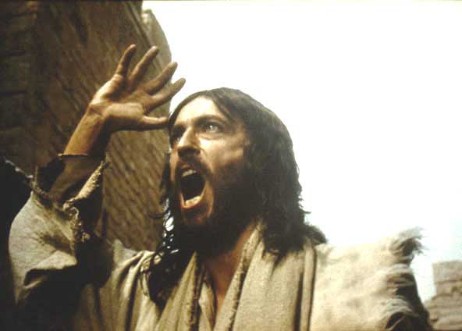
Why Was Jesus So Upset?
SMCOC-DC-2011

Slide 4
Why Was Jesus So Upset?
“But if the journey is too long for you, so that you are not able to carry the tithe…then you shall exchange it for money, take the money in your hand, and go to the place which the LORD your God chooses.” Deuteronomy 14:24-25
SMCOC-DC-2011

Slide 5
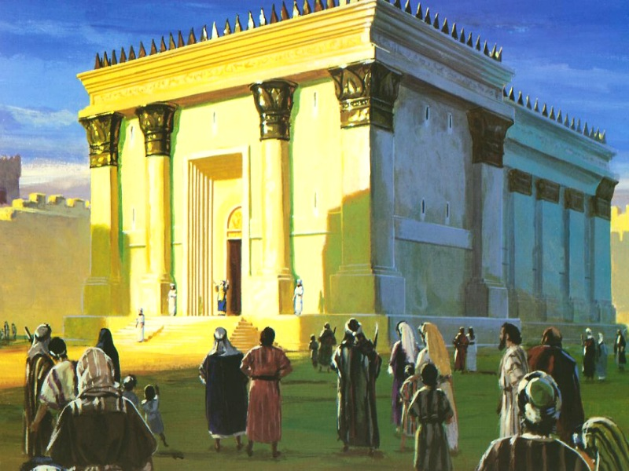
The Temple of God
Designed by God to be His throne
SMCOC-DC-2011

Slide 6
The Temple of God
Designed by God to be His throne
Used by men for their own profit
SMCOC-DC-2011

Slide 7
Eve of Monday
The goal of this entry was CLEANSING
SMCOC-DC-2011

Slide 8
Eve of Monday
The goal of this entry was CLEANSING
“Then the blind and the lame came to Him in the temple, and He healed them.” Matthew 21:14
SMCOC-DC-2011

Slide 9
Jesus Cleans House
“For the time has come for judgment to begin at the house of God” 1 Peter 4:17
SMCOC-DC-2011

Slide 10
Jesus Cleans House
“Sing, O daughter of Zion! Shout, O Israel! Be glad and rejoice with all your heart, O daughter of Jerusalem! The LORD has taken away your judgments, He has cast out your enemy. The King of Israel, the LORD, is in your midst; You shall see disaster no more.
SMCOC-DC-2011

Slide 11
Jesus Cleans House
In that day it shall be said to Jerusalem: “Do not fear; Zion, let not your hands be weak. The LORD your God in your midst, the Mighty One, will save; He will rejoice over you with gladness, He will quiet you with His love, He will rejoice over you with singing.” Zephaniah 3:14-17
SMCOC-DC-2011

