Slide 1

Traits of a Church that Heaven Applauds

Slide 2
Irresistible Church
AN IRRESISTIBLE CHURCH CHOOSES TO LEARN AND ADAPT

Slide 3
Numbers 20:8-12
“Take the rod; you and your brother Aaron gather the congregation together. Speak to the rock before their eyes, and it will yield its water; thus you shall bring water for them out of the rock, and give drink to the congregation and their animals.”
So Moses took the rod from before the Lord as he commanded him.
And Moses and Aaron gathered the assembly together before the rock; and he said to them, “Hear now, you rebels! Must we bring water for you out of this rock?”

Slide 4
Then Moses lifted his hand and struck the rock twice with his rod; and water came out abundantly, and the congregation and their animals drank.
Then the Lord spoke to Moses and Aaron, “Because you did not believe Me, to hallow Me in the eyes of the children of Israel, therefore you shall not bring this assembly into the land which I have given them.”

Slide 5
Churches stuck in routine lose opportunities to honor God

Slide 6
In order to be the church that God wants us to be, we must continue to learn, unlearn, and relearn

Slide 7
One of the best ways to keep learning is from an unlikely source- the mistake

Slide 8
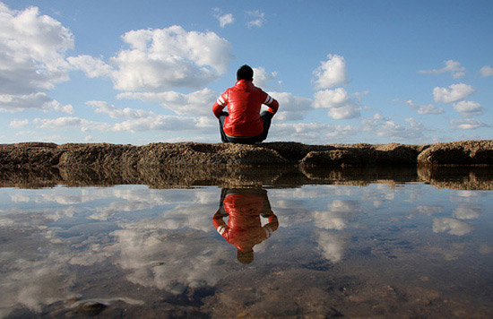
The Church that’s always learning
An important component of learning is: Reflection

Slide 9
Experience + Reflection = Insight

Slide 10
Deuteronomy 5:15
“And remember that you were a slave in the land of Egypt, and the Lord your God brought you out from there by a mighty hand and by an outstretched arm; therefore the Lord your God commanded you to keep the Sabbath day.”

Slide 11
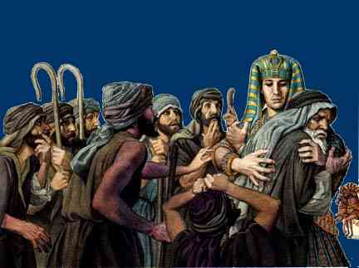
Genesis 50:20
“ But as for you, you meant evil against me; but God meant it for good, in order to bring it about as it is this day, to save many people alive.”

Slide 12
Proverbs 1:7
“A wise man will hear and increase learning, And a man of understanding will attain wise counsel,”

Slide 13
2 Corinthians 6:1
“We then, as workers together with Him also plead with you not to receive the grace of God in vain.”

Slide 14
An irresistible church connects everything to a soul!

Slide 15
James 5:19-20
“Brethren, if anyone among you wanders from the truth, and someone turns him back, let him know that he who turns a sinner from the error of his way will save a soul from death and cover a multitude of sins.”

Slide 16
Irresistible Church
A church that is irresistible to heaven is a church that chooses to love

Slide 17
1 Peter 4:8
“And above all things have fervent love for one another, for “love will cover a multitude of sins.”

Slide 18
In the original Greek the word “fervent” means” to stretch or strain

