Slide 1
“Glory to God in the highest, and on earth peace, goodwill toward men!”
Glorious Feast of the Nativity
January 6, 2011

Slide 2
Peace of God or God of peace?
“Now the God of peace be with you all. Amen.” Romans 15:33
“but I want you to be wise in what is good, and simple concerning evil. And the God of peace will crush Satan under your feet shortly.” Romans 16:19-20

Slide 3
John 16:20-21
“Most assuredly, I say to you that you will weep and lament, but the world will rejoice; and you will be sorrowful, but your sorrow will be turned into joy. A woman, when she is in labor, has sorrow because her hour has come; but as soon as she has given birth to the child, she no longer remembers the anguish, for joy that a human being has been born into the world.

Slide 4
John 16:22
Therefore you now have sorrow; but I will see you again and your heart will rejoice, and your joy no one will take from you.

Slide 5
John 16:24
Until now you have asked nothing in My name. Ask, and you will receive, that your joy may be full.

Slide 6
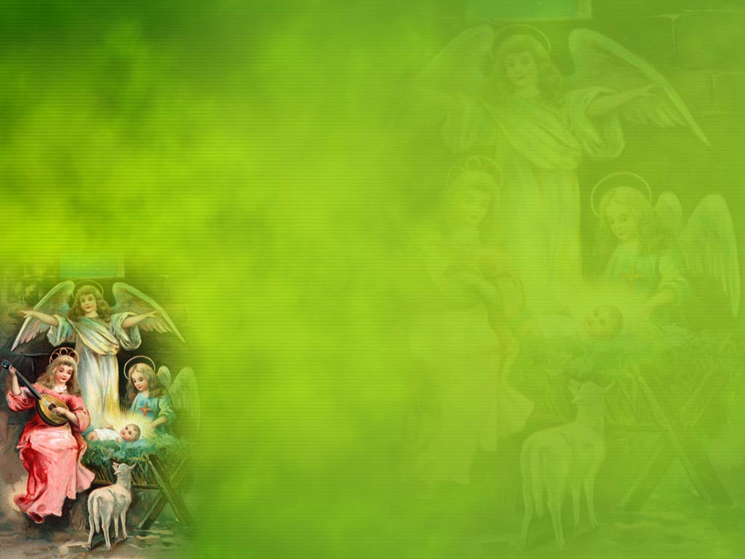
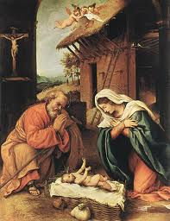
Emmanuel, God with us

Slide 7
“For to us a Child is born, unto us a Son is given, and the government will be on his shoulders. And he will be called Wonderful Counselor, Mighty God, Everlasting Father, Prince of Peace.
Of the greatness of his government and peace there will be no end. He will reign on David’s throne and over his kingdom, establishing and upholding it with justice and righteousness from that time on and forever.” Isaiah 9:6-7

